Slide 2
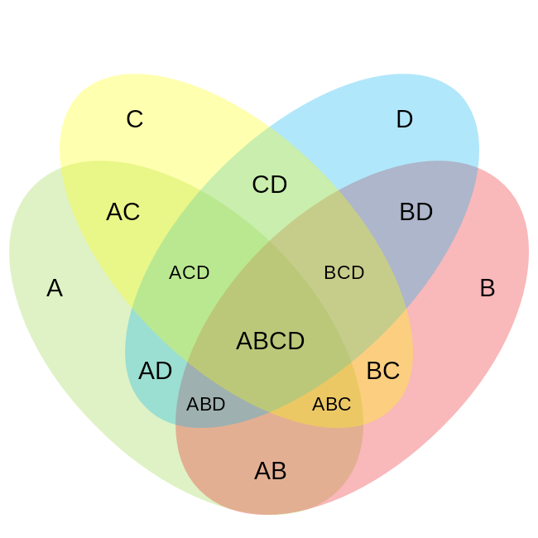
A = Meeting Attendees
B = EIP Authors
C = EIP Contributors
D = Client Contributors
N (Everyone Involved with Development) = 2,106
172
1,013
43
43
70
16
43
135
193
16
25
234
25
43
74

